Slide 1
Face Detection using CNN
Deep Learning Practical - 5

Slide 2

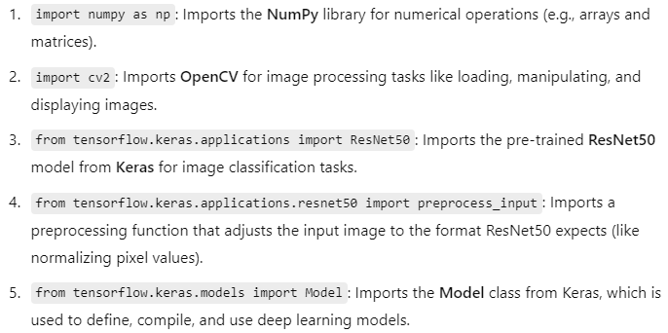
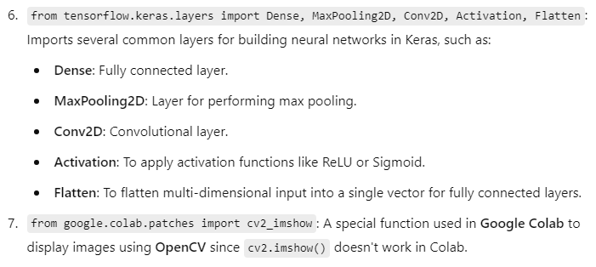
ResNet50 is a pre-trained model that has 50 layers and has been trained on a large dataset, typically ImageNet (which contains millions of labeled images). It can recognize a wide variety of objects and is often used as a starting point for tasks like image classification.

Slide 3


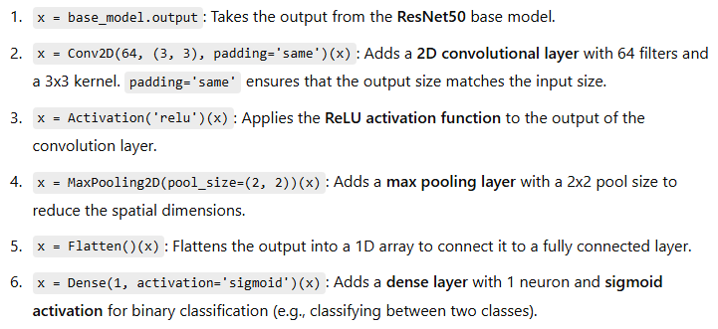

Slide 4





Slide 5

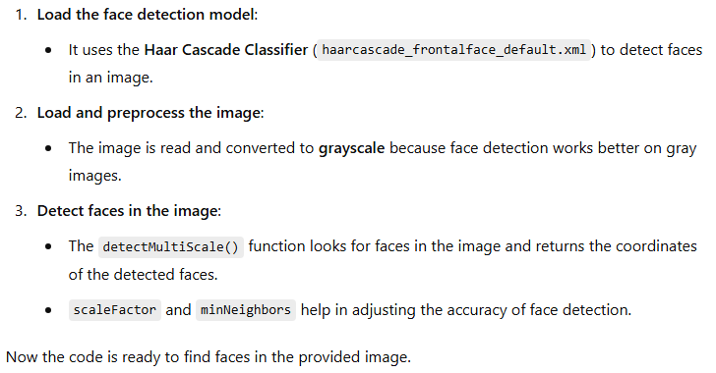

Slide 6
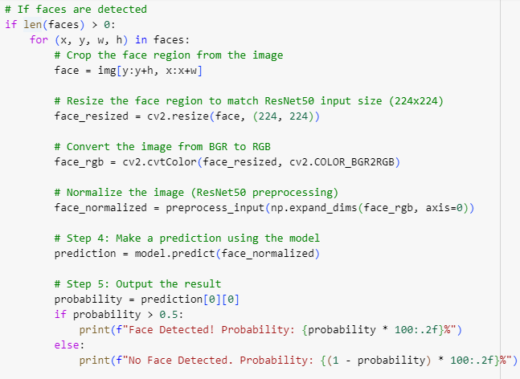
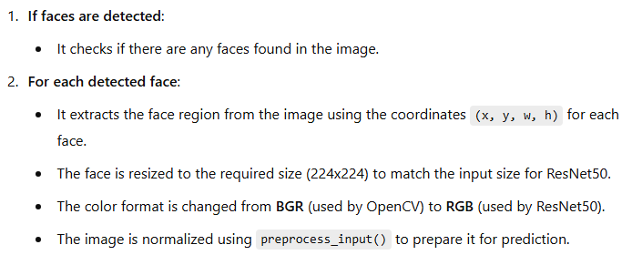


Slide 7

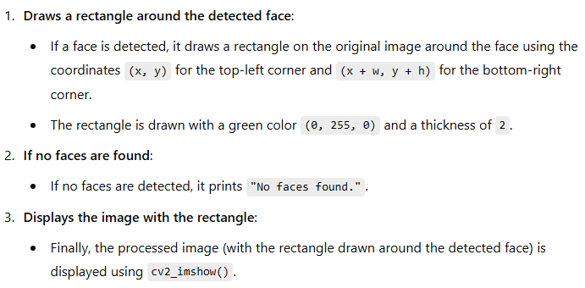

Slide 8
